Slide 1

MACHINE LEARNING
Share Price Prediction
By Antoinette and Stella

Slide 2
PROJECT 3 DEMYSTIFYING ML
Team members: Antoinette Boyle, Stella Schubert
Title: Analysing the Top 5 ASX Share Market Capitalisation Companies
Dataset: Yahoo Finance history downloads
Companies: BHP, CBA, CSL, NAB and WBC

Slide 3
Data
Yahoo Finance history downloads
CSV format
ETL
Mongo Db

Slide 4
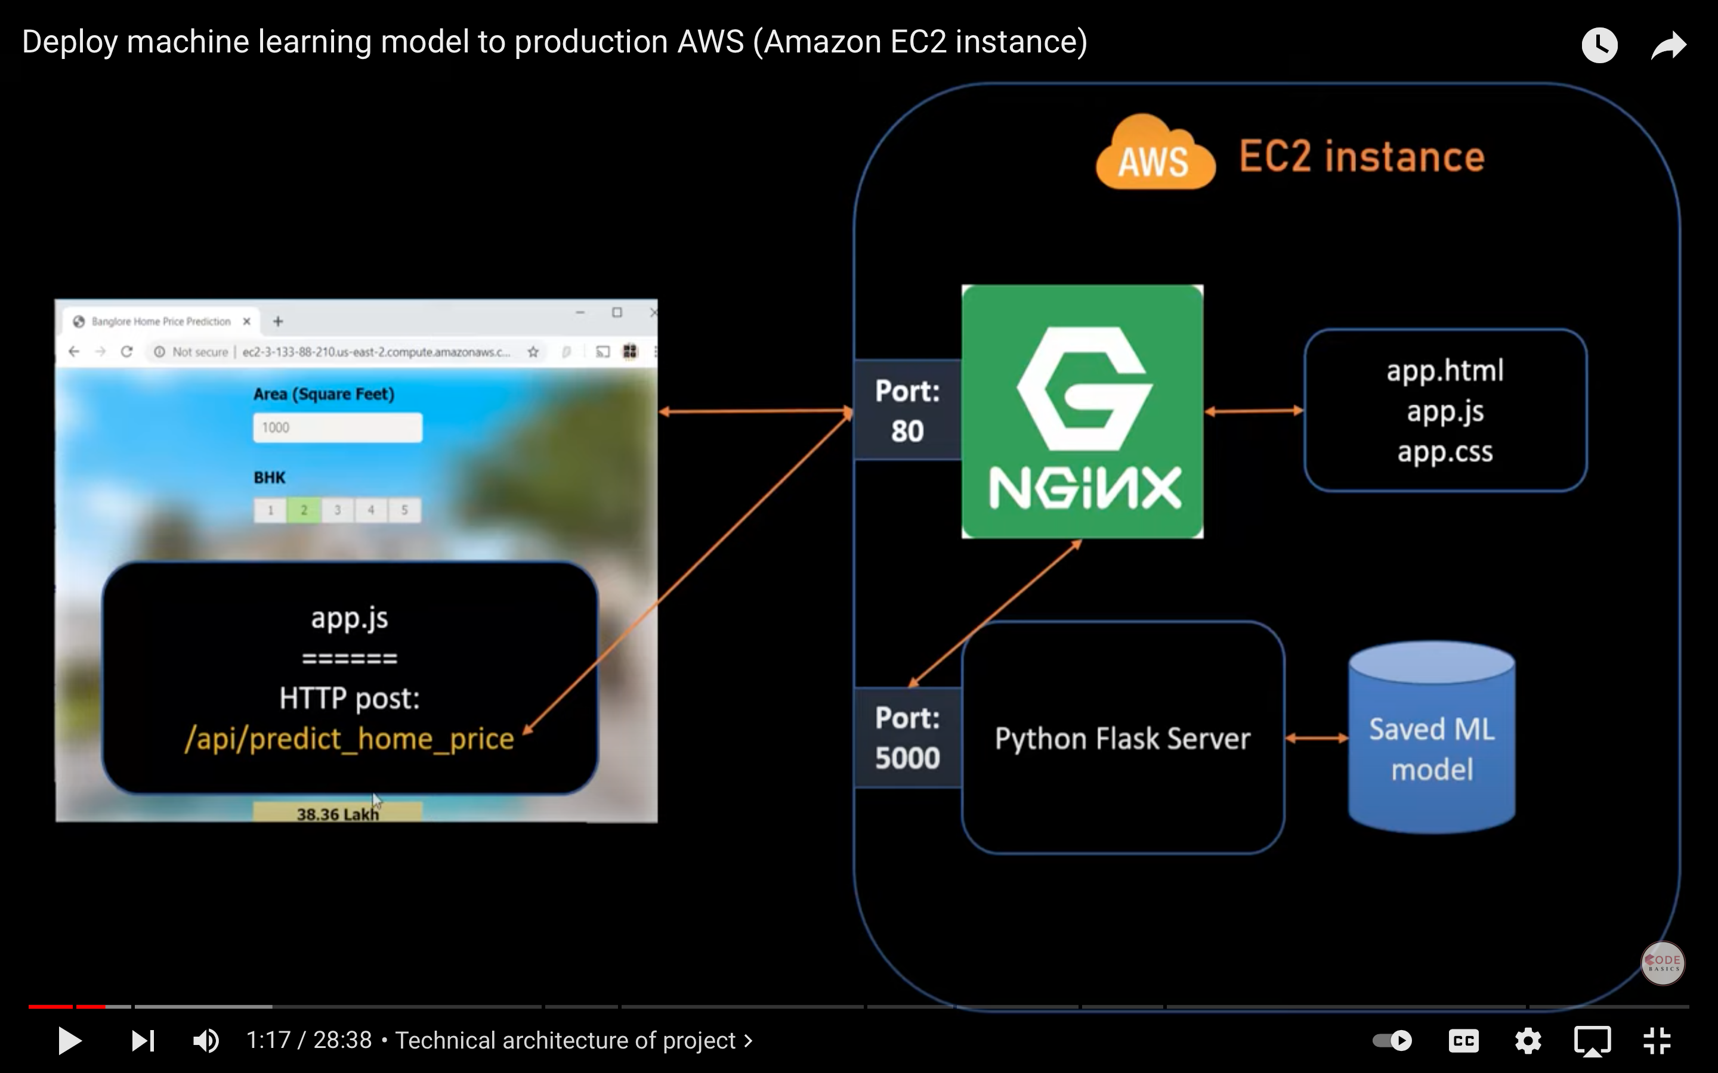
AWS

Slide 5
Which Model?
Sequential Model
Long short-term memory (LSTM)
Recurrent neural network (RNN) architecture
Share price prediction using a weighted average over 60 days
Considered other models such as:
Sequential Neural Network
Hyperparameter tuning with GridsearchCV

Slide 6
Model Creation
Preprocessing
Split into Training and Testing data
Tested Predictions
Plotted the data between testing and training
Saved the Model

Slide 7
DEMO

Slide 8
Further features
Add more companies to Website
Additional visualisations and graphs
Using MongoDb to scrape data
QUESTIONS

